Slide 1
12-Month Roadmap
Money Banger Bank PLC
2025 / Q1 / January
Capstone Project | Product Manager
Notes:
This project shows a comprehensive 12-month product roadmap for Money Banger Bank's new mobile application, prioritizing features strategically across four quarters to ensure we deliver a secure, user-friendly digital banking experience.

Slide 2
Project overview
Money Banger Bank PLC is launching a comprehensive mobile banking application to enhance digital customer experience and maintain competitive advantage in the fintech landscape.
This project shows a 12-month roadmap for the development of the new mobile banking application with 24 features and 4 quarterly releases. This roadmap will:
Guide phased feature delivery
Prioritize business needs, user experience, and compliance
Align with agile development principles for adaptability

Slide 3
Features Prioritization Method
MoSCoW Prioritization Technique
Must Have
Should Have
Critical features for MVP
Important value drivers but not critical to launch.
Could Have
Won’t Have Yet
Desirable enhancements
Out of scope for now; will be considered in the future.
Notes:
MoSCoW Categories:
Must Have: Core features required for launch that address security, compliance, and basic banking functionality
Should Have: Important features that provide significant value but aren't absolutely essential for initial launch
Could Have: Desirable features that enhance the user experience but could be developed later
Won't Have (Yet): Features planned for future versions after the initial 12-month roadmap

Slide 4
Features Prioritization List
Priority | Feature | Rationale
Must Have | Secure Sign-up/Login, Two-Factor Authentication, KYC, View Balance | Security, Compliance, Core Banking
 | Internal & External Transfers In-App Customer Support Ticketing | Essential for transactions
Should Have | Bill Payments, Recurring Payments, Transaction Alerts,Biometric Auth, Multiple Bank, P2P Transfers, Live chat support Fraud Detection & AI-based Risk Analysis | Improves convenience and user engagement
 | Card Management (Lock, Apply, Freeze) | Self-service tools
Could Have | EMI Calculator, Auto & Home Loans, QR Code Payments, scheduled payments, Branch and ATM locator, FAQs & Knowledge Base | Adds value, non-blocking
Won’t Have | Savings Goals & Automated Savings, Fixed Deposits & Recurring Deposits, Stock & Mutual Fund Investments | Not a current business focus
Notes:
Rationale for Feature Prioritization
Title: Why These Features?
Business Impact:
Must-Haves drive early adoption and ensure app utility
Should-Haves improve user satisfaction and retention
Could-Haves offer competitive differentiation
Security & Regulatory Needs:
KYC, 2FA, and fraud detection features included early to meet compliance
Privacy-sensitive features (e.g., biometrics) prioritized for trust-building
User Experience:
Features released in logical flow: access → transact → manage → grow
Early wins (login, transfers, alerts) ensure high engagement

Slide 5
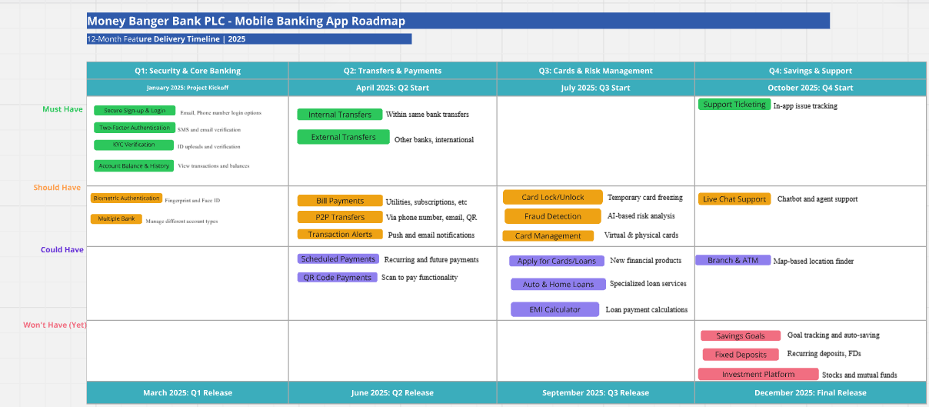
12- Month Visual Roadmap
https://miro.com/app/board/uXjVIzqW83k=/
Notes:
This visual roadmap is a Miro board for Money Banger Bank PLC's mobile banking app. This visualization gives stakeholders an easy-to-understand overview of the 12-month development plan with the following key elements:
Visual Roadmap Features
Quarterly Organization: The roadmap is divided into four quarters (Q1-Q4), each with its own strategic focus:
Q1: Security & Core Banking
Q2: Transfers & Payments
Q3: Cards & Risk Management
Q4: Savings & Support
MoSCoW Prioritization: Features are color-coded to indicate their priority level:
Green(Must Have): Essential features required for launch
Orange (Should Have): Important features that provide significant value
Purple (Could Have): Desirable features that enhance the experience
Pink (Won't Have Yet): Features planned for future versions
Dependencies: The roadmap shows relationships between features, indicating which ones must be completed before others can begin
Milestones: Key project milestones are marked at the beginning and end of each quarter
This visual roadmap serves multiple purposes:
Strategic Communication: Provides a clear overview of the project timeline for all stakeholders
Resource Planning: Helps development teams understand dependencies and sequencing
Priority Visualization: Makes it immediately clear which features are most critical
Progress Tracking: Can be updated throughout the project to show completion status

Slide 6
Roadmap Overview Q1: Security & Core Banking Foundation
Strategic Focus
Key Features
Success Metrics
Dependencies
January -March 2025
Establish robust security infrastructure and deliver core banking functionalities required for regulatory compliance and user trust.
Secure Sign-up & Login (Multi-channel)
Two-Factor Authentication (SMS/Email)
Biometric Authentication (Face ID/Fingerprint)
KYC Verification (ID Upload & Selfie)
Account Balance & Transaction History
Multiple Bank Account Management
100% compliance with security regulations
90% successful user onboarding rate
<1.5 second average load time for core screens
Banking API Integration
KYC Service Provider Setup
Security Audit Completion
Regulatory Approval
788
Notes:
Quarterly Breakdown Development Focus
1: Core Security & Banking Foundation (Months 1-3)
Theme: Security First
I've prioritized establishing our security infrastructure and core banking capabilities to ensure we build on a solid foundation:
Secure authentication system with multiple login options
Biometric security features for enhanced protection
KYC implementation for regulatory compliance
Basic account management for viewing balances and transactions
This quarter focuses on delivering an MVP that meets regulatory requirements while providing essential functionality.

Slide 7
Roadmap Overview Q2: Payment & Transfer Ecosystem
Strategic Focus
Key Features
Success Metrics
Dependencies
April -June 2025
Comprehensive money movement capabilities
Bill payment infrastructure
User notification system
Internal Transfers (Within Same Bank)
External Transfers (Other Banks, International)
Scheduled & Recurring Payments
Bill Payments (Utilities, Subscriptions, etc.)
Peer-to-Peer Transfers (via Phone, Email, QR Code)
QR Code Payments
Transaction Alerts & Notifications
95% transaction success rate
User adoption rate of 60%
Average transfer completion time under 30 seconds
Q1 Authentication System
Payment Gateway Integration
Inter-bank Network Setup
Notification Service
788
Notes:
Q2: Payment & Transfer Ecosystem (Months 4-6)
Theme: Transaction Excellence
Building on our secure foundation, Q2 focuses on comprehensive money movement capabilities:
Complete transfer system for internal and external transactions
Bill payment infrastructure for utilities and subscriptions
P2P transfers for easy person-to-person payments
Transaction notifications to enhance security and communication
These features represent the core functionality most users expect from a banking app, driving adoption and regular usage.

Slide 8
Roadmap Overview Q3: Risk Management & Financial Products
Strategic Focus
Key Features
Success Metrics
Dependencies
July -September 2025
Fraud prevention infrastructure
Card management system
Loan application platform
Card Lock/Unlock & Temporary Freezing
Fraud Detection & AI-based Risk Analysis
Virtual & Physical Debit/Credit Card Management
Apply for New Cards or Loans
EMI Calculator
Auto & Home Loan Services
Fraud detection accuracy >98%
40% of physical card holders activating digital management
25% increase in loan application starts
Account structure Transaction history
AI integration
788
Notes:
Q3: Risk Management & Financial Products (Months 7-9)
Theme: Security & Financial Expansion
In Q3, we expand into more advanced security features and additional financial products:
Fraud detection systems powered by AI to protect users
Card management capabilities for digital control of physical cards
Loan application platform to streamline access to credit products
This quarter enhances user trust while expanding revenue opportunities through additional financial products.

Slide 9
Roadmap Overview Q3: Wealth Management & Support
Strategic Focus
Key Features
Success Metrics
Dependencies
October -December 2025
Investment platform
Automated savings tools
Multi-channel customer support
Savings Goals & Automated Savings
Fixed Deposits & Recurring Deposits
Stock & Mutual Fund Investments
Live Chat & Chatbot Support
In-App Customer Support Ticketing
FAQs & Knowledge Base
Branch & ATM Locator
30% of users creating at least one savings goal
Customer satisfaction score >4.5/5
Support response time under 4 minutes
Balance tracking
Transaction Audit Trail
788
Notes:
Q4: Wealth Management & Support (Months 10-12)
Theme: Customer Growth & Retention
The final quarter focuses on features that drive long-term engagement and customer satisfaction:
Investment platform for wealth building
Savings tools for financial goal achievement
Multi-channel support options for customer assistance
These features transform the app from a transactional tool to a comprehensive financial management platform.

Slide 10
Implementation Considerations
Development Approach
Cross Functional Collaboration
Agile Methodology: Two-week sprints with regular stakeholder demos
Continuous Integration/Continuous Deployment: Frequent small releases to catch issues early
Feature Flags: Ability to enable/disable features without redeployment
Product Team: Roadmap ownership and prioritization
Engineering: Frontend, backend, and mobile development
Security & Compliance: Regulatory requirements
UX/UI Design: User experience and interface design
QA: Testing and quality validation
Quality Assurance
Technology Stack
Automated unit and integration testing
Manual testing for critical user flows
Security testing at each milestone
Performance testing with load scenarios
API-First Approach: Well-documented APIs for all core banking functions
Scalable Backend: Architecture that can handle growth in user base
Cross-Platform Development: Single codebase for iOS and Android

Slide 11
Success Metrics and KPI
We'll measure success through several key performance indicators:
User Adoption: Percentage of bank customers using the mobile app
Feature Usage: Engagement metrics for key features
Security Incidents: Number and severity of security-related issues
Customer Satisfaction: App store ratings and customer feedback
Transaction Volume: Number and value of transactions processed
Notes:
Critical Success Factors
Cross-functional Collaboration: Regular alignment between Product, Engineering, Security, and Compliance teams
Agile Development: Two-week sprints with continuous feedback and iteration
User-Centric Design: Ongoing user research and usability testing
Quality Assurance: Comprehensive testing at each release milestone

Slide 12
Company Name
Recommendation and Next steps
Immediate Action
Next 30 days
Q1 Preparation
Next 60 Days
Success Enablers
Stakeholder Approval: Secure executive sign-off on roadmap and budget
Team Assembly: Finalize core development team and key roles
Vendor Selection: Choose KYC, payment gateway, and security partners
Architecture Design: Complete technical architecture and security review
Compliance Review: Ensure regulatory requirements are fully understood
Set up development environment and CI/CD pipeline
Complete detailed feature specifications for Q1 features
Conduct user research and finalize UX designs
Establish security protocols and testing procedures
Create project management and communication frameworks
Executive Sponsorship: Maintain C-level support throughout the project
Cross-functional Alignment: Regular sync meetings with all key stakeholders
Customer Feedback: Establish channels for continuous user input
Agile Adaptation:
Notes:
Next Steps & Recommendations
Immediate Actions (Next 30 Days)
Stakeholder Approval: Secure executive sign-off on roadmap and budget
Team Assembly: Finalize core development team and key roles
Vendor Selection: Choose KYC, payment gateway, and security partners
Architecture Design: Complete technical architecture and security review
Compliance Review: Ensure regulatory requirements are fully understood
Q1 Preparation (Next 60 Days)
Set up development environment and CI/CD pipeline
Complete detailed feature specifications for Q1 features
Conduct user research and finalize UX designs
Establish security protocols and testing procedures
Create project management and communication frameworks
Success Enablers
Executive Sponsorship: Maintain C-level support throughout the project
Cross-functional Alignment: Regular sync meetings with all key stakeholders
Customer Feedback: Establish channels for continuous user input
Agile Adaptation:

Slide 13
Thank you
Notes:
This 12-month roadmap provides a strategic framework for delivering a secure, feature-rich mobile banking application for Money Banger Bank PLC. By prioritizing security and core functionality first, we establish a solid foundation before expanding into more advanced features that drive engagement and retention.
The phased approach allows for:
Early delivery of essential functionality
Regular feedback cycles to refine features
Risk management through incremental deployment
Flexibility to adjust priorities based on market changes
With proper execution of this roadmap, Money Banger Bank will establish a competitive digital presence that meets customer needs while ensuring security and compliance.

